Slide 1



Employee attraction data

Slide 2
BACKGROUND
The data set used is from Kaggle.com
The data set consists store information of employee’s that have been hired from the year 2000-2013
The data set look at individual employee demographics and reasons of contract termination
The Visualization was created using QlikView

Slide 3
BACKGROUND :Questions
With the project, I tried to find answers and understand the following questions and factors that might have contributed to employees contract terminations
What is the major reason of contract termination ?
Which department and job title, that have high total of terminated contracts?

Slide 4
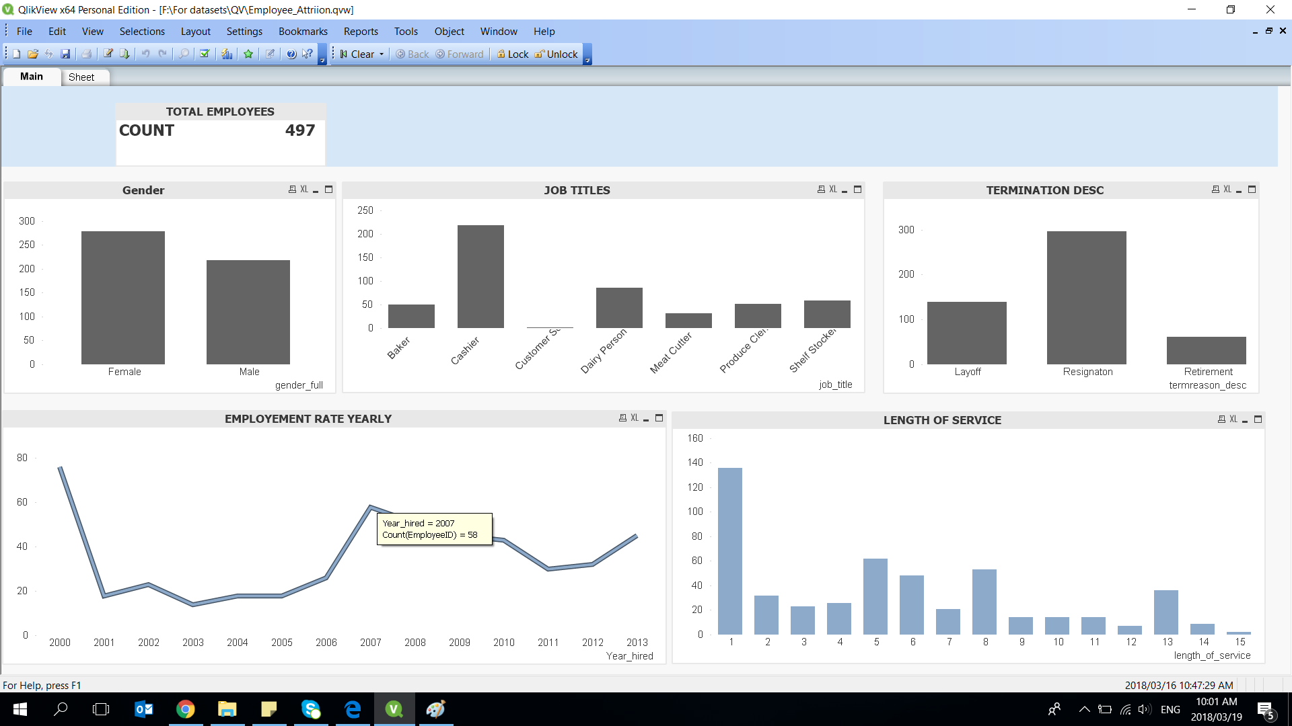
The report shows that 497 employees terminated their contracts and mostly it was female gender
More employees resigned, followed by layoff and last its retirement on the lower trend
Cashiers are the mostly who terminate their contracts within a length of 1 year service

Slide 5
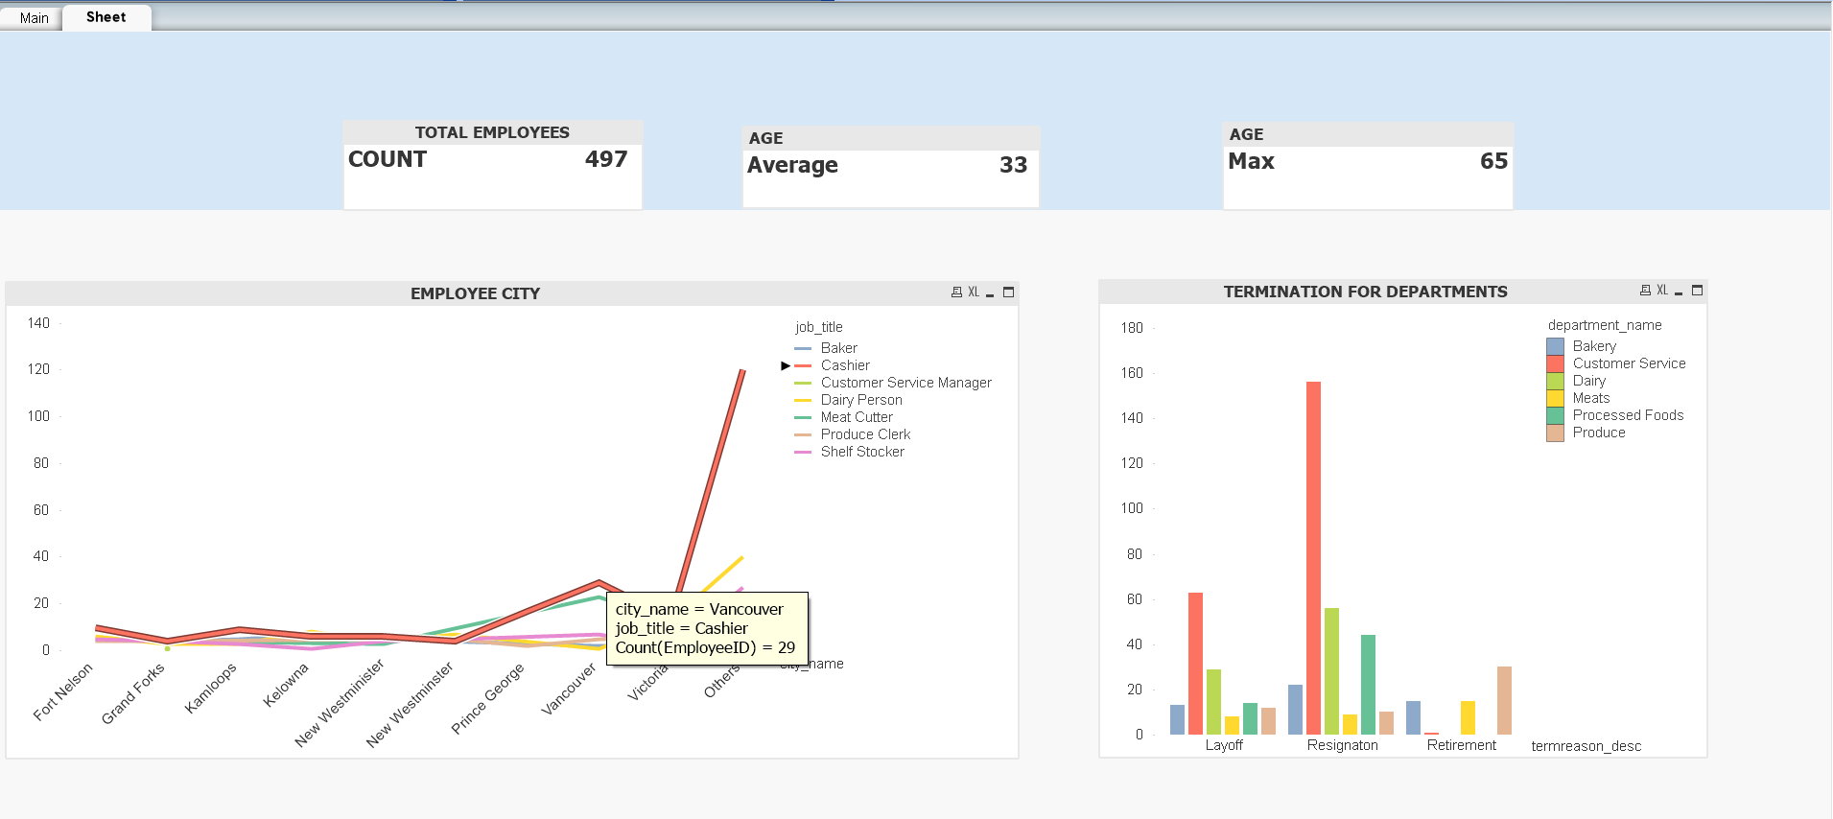
Report shows that more employees who terminated their contracts are from Vancouver City, with job Titles Cashier and they work in customer service department with high resignation rate.

Slide 6
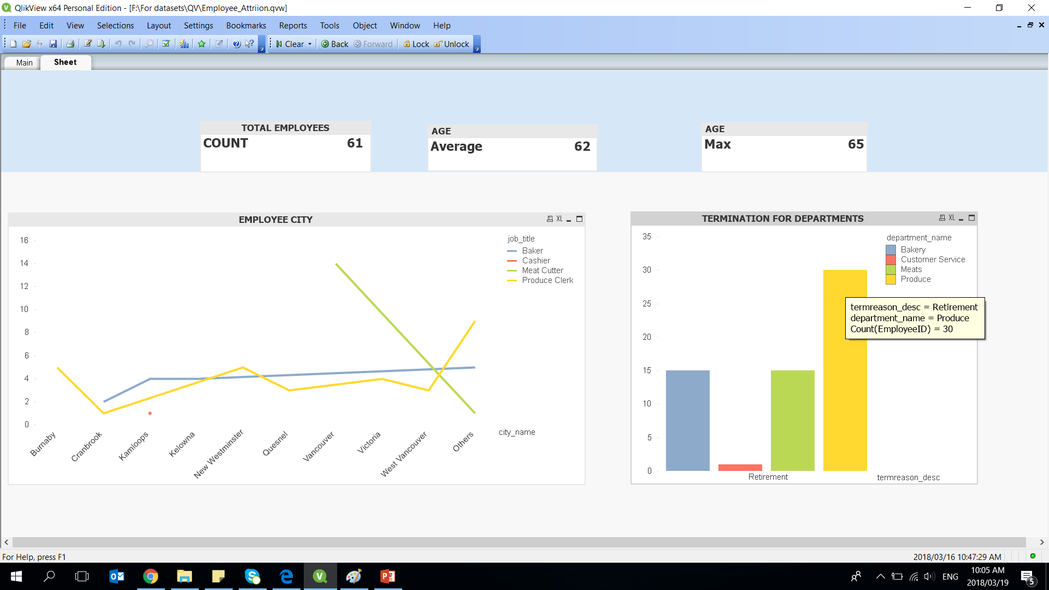
Looking at retirement, report shows 61 over 497 employees retired, the average age is 61 years with maximum age of 65, this is the most age people retire.
Report also shows department of the employees who retired and their job titles.

Slide 7
RESULTS
From the findings it shows that cashiers are the most who resigned within 1 year length of service.
Age might have been a major factor as the average shows that employees resigned around 26 years.
City also show a bigger trend, Employees from Victoria terminate their contracts more followed by

